Slide 1
BU Course Builder
Group 1 (Eagles!)

Slide 2
Team Introduction
Natasha Liew (Team Leader)
Ananya Singh (Security Lead)
Battal Cevik (QA Lead)
Natthaphon Foithong (Design and Implementation Lead)
Poom Chantarapornrat (Requirement Lead)
Yu Jun Liu (AJ) (Configuration Lead)

Slide 3
Overview of project
Personalized AI Course-Builder Application
Features include: chat history sharing, emailing, caching, and user authentication
Related work: Coursera, Degree Compass

Slide 4
Tech Stack
Languages: Typescript, Java, Python
Frameworks: React, Redux, Spring Boot, Flask
Databases: Postgres, MongoDB
Authentication: Okta
LLM: Llama 2
APIs: Hugging Face API

Slide 5
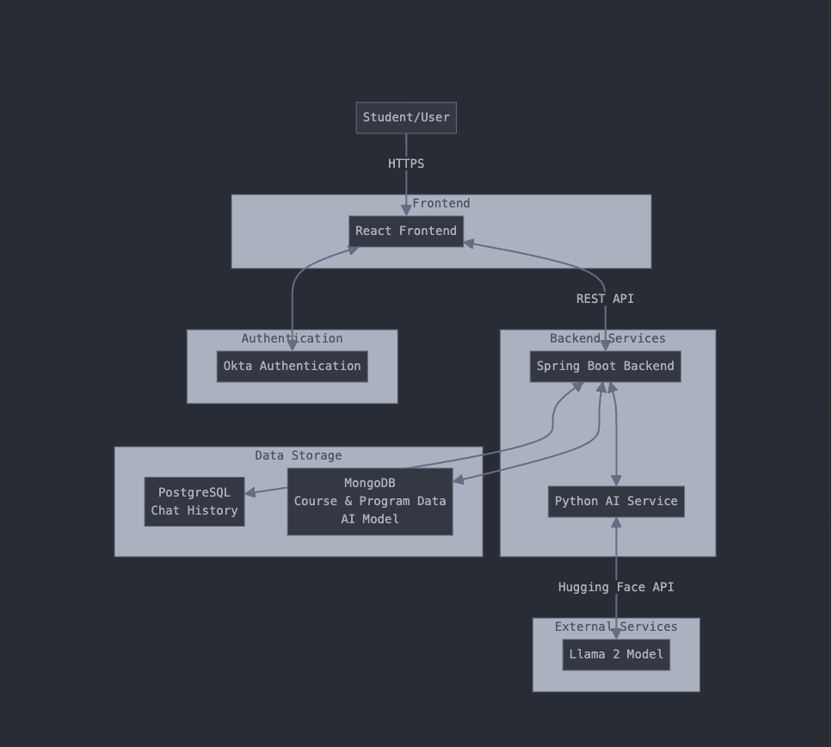

Slide 6
Management Plan
Front-End Development (Front-End Engineer) -> Nat
Back-End Development (Java and DB Team) -> Ananya/AJ
Integrated CI/CD and Testing (QA Lead) -> Battal
AI Service Development (AI Team) -> Natasha/Poom

Slide 7
Configuration
Tools: Github, IDEs, CI/CD tools, Github Issues, potentially Docker
Branching strategy: Three different branches (main, stage, development)
Feature branches: feature/member-name-feature-description
Pull Requests strategy
Must be submitted to development branch for review
Needs one other team member review and approval
Must pass all checks in CI/CD pipeline before merging

Slide 8
Quality Assurance
Comprehensive Quality Assurance Plan
Robust Coding Standards & Review Process
Multi-Tiered Testing Strategy
Automated Testing Framework
Efficient Defect Management

Slide 9
Risk Management
Main risks identified: dropping out, lack of motivation, and inconsistent work output
Communication via Discord
Aware of integration challenges, lack of testing, and technology learning curves

Slide 10
Team Github and UI Mockups
https://github.com/BUMETCS673/seprojects-cs673olf24team1
https://www.figma.com/design/gjNG1bADwnFxgDqclMwQVQ/Chat-AI-Bot---673ONE---final-mockup?node-id=0-1

